Slide 1
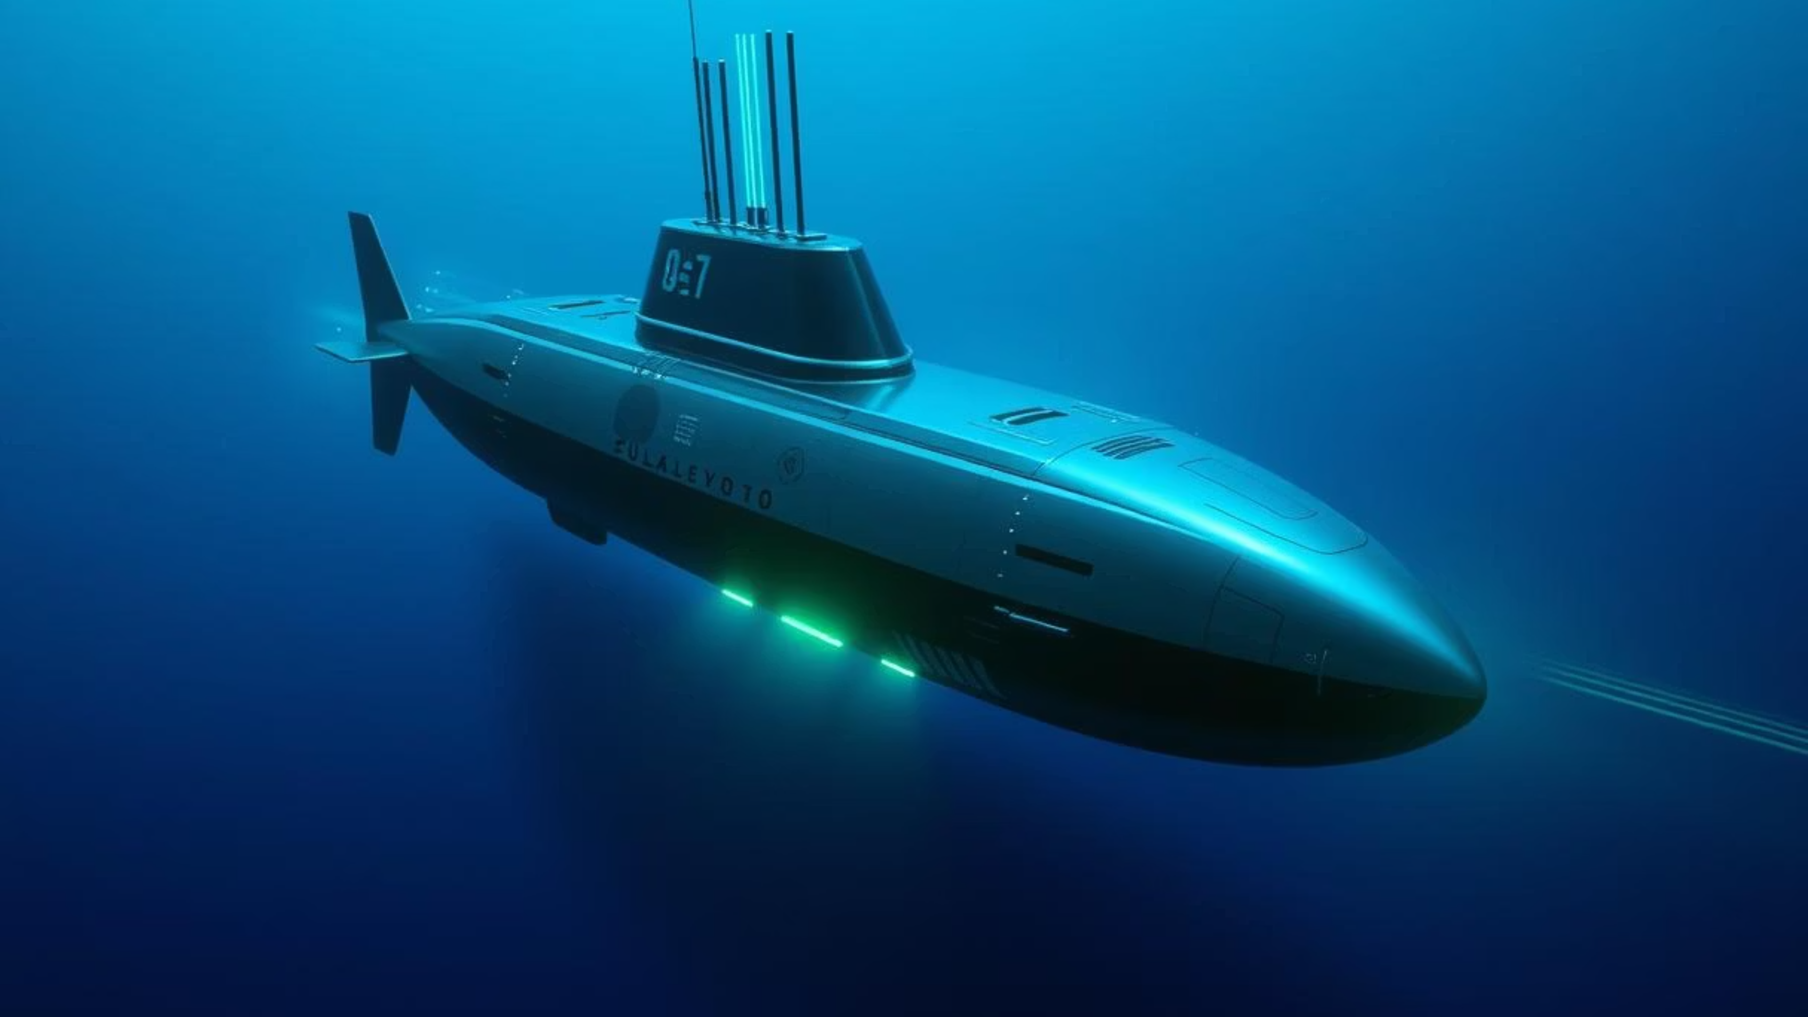
Smart Escapism: AI-Powered Decoy Deployment System for Submarine Defense

Slide 2
NexTech 1.0
Team Name: Code Catalyst
Problem Statement Title: SMART ESCAPISM - An AI Powered Decoy Deployment System For Submarine Defense.
Team Leader Name: Sibani Sahu
Institute Name: Ravenshaw University
Team Leader Contact Number: 9692798947
Team Member's Name: Sibani Sahu, Puja Das

Slide 3
Challenges in Current Situation
Limited Autonomy
1
Traditional decoy lack AI-driven decision making. Modern sensors cannot predict the future possibility of threat by measuring variable factors.
Manual & Remote
2
Current decoys are still deployed manually, locally or via remote control. Human intervention is still necessary which increases risks under surprise attack.
Time Consuming
3
This causes delays in urgent situation where split-second decisions are essential. Reaction time is critical-even a few seconds of delay may make the decoy ineffective.

Slide 4



We Suggest: AI-Driven Smart Decoy Deployment
Future threat Anticipation
Use Probabilistic classification method to combine all sensor clues into one probability and predict the likelihood of threat.
Autonomous Decision
Random Forest Classifier selects the best decoy placement instantly.
Deployment
System triggres the command to release the decoy in the measuresd position with minimal human delay.

Slide 5
Technology and Capabilities
AI & Machine Learning - Intelligent Desicion Making
Enable autonomous threat detection, prediction of future trajectory and optimized decision-making.
SVM with Sensor Fusion- Predict Future Probabilities
Integrates sonar, radar, infrared and acoustic data to calculate overall threat probability.
Operational Safety
Reduces false negatives (missed threats) with strong evaluation metrics (Confusion Matrix, ROC).
Modular Design
Two-stage architecture allows independent upgrades (detection model or deployment strategy
Instant Reaction
Ensures instant analysis and rapid decoy deployment within seconds.

Slide 6


Technology Stack
1. Programming & Framework
2. Data Processing
3. Machine Learning
python→ AI backbone
Pandas → Data handling
SVM (RBF) → Best accuracy
streamlit→ Inteactive UI
NumPy → Math operation
Naive Bayes → Baseline model
StandardScaler → Feature scaling
Random Forest → Robust learning
RF Classifier/Regressor → Location & severity
4 .Visualization
5. Datasets
6. Deployment & Access
Matplotlib → Graphs & plots
Augmented Sonar Dataset → Threat detection
Google Colab → runs the backend & ML models.
Streamlit Maps/Heatmaps → Live visuals
Synthetic Historical Attacks → Attack patterns
Streamlit → builds the interactive UI.
Ngrok with Auth Token → exposes the local Streamlit app securely to the internet.
7.End-to-End Access Pipeline
Google Colab → Streamlit App → Ngrok (Authtoken Secured) → Browser

Slide 7

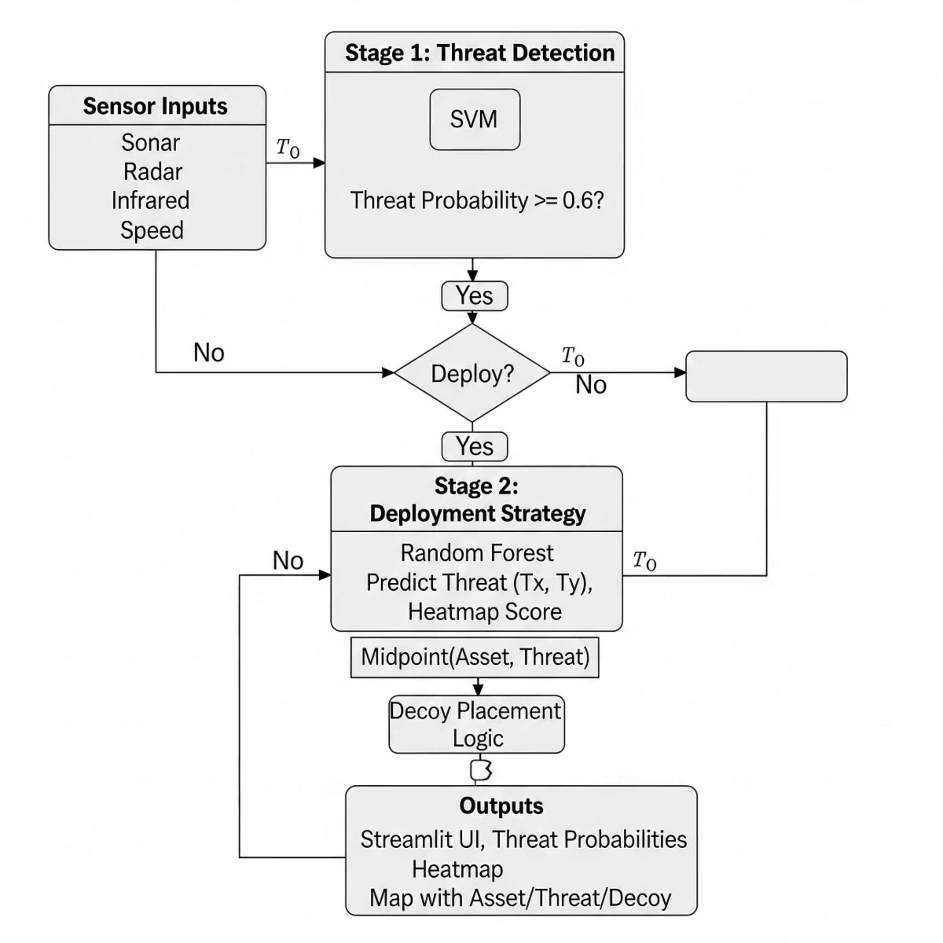
Overall Architecture Model
Our system operates through a seamless integration of intelligent modules, ensuring rapid analysis and decisive action.
1
Sensor Inputs
Collects real-time environment data from sonar, radar, infrared, and speed.
2
Stage 1 – Threat Detection (SVM)
Analyzes sensor data to instantly detect threats with probability scoring
3
Stage 2 – Deployment Strategy (Random Forests)
Predicts enemy location and severity using historical attack patterns
4
Decoy Logic (Midpoint Placement)
Calculates the optimal decoy position between submarine and predicted threat
5
Outputs – Streamlit UI
Displays threat probability, heatmap, and real-time map for operator clarity.

Slide 8
Impacts and Benefits
1. Reduces Human Workload
2. Cost-Effective
Minimizes manual monitoring, allowing operators to focus on high level decisions.
Provides a highly effective alternative to expensive stealth technology upgrades for existing fleets.
3. Strategic Deception
4. Instant threat response
Allows for the manipulation of enemy sensor data creating tactical advantages in critical situations.
AI eliminates delays by automatically analyzing sensor data and deploying decoys within seconds.
5. Enhanced Survivability
6. Scalable Application
Dramatically increases the chances of mission success and crew safety by minimizing detection risk.
Adaptable for integration across various underwater platforms and diverse mission profiles.

